Slide 1
Blood Flagellates
1- Are Protozoa that swim in the blood of patients using
خيط
flagellum (mastigote) then invade their tissues.
2- Transmitted to man through arthropods bite
3- Include:
Leishmania
& Trypanosoma
4- Acquire the following shapes:
Amastigote
Trypomastigote
kinetoplast
Undulating membrane
oval
No free flagellum
Free Flagellum
Eccentric nucleus
Central nucleus
Promastigote
Epimastigote
elongated
kinetoplast
kinetoplast
Free Flagellum
Free Flagellum
Central nucleus
Undulating membrane
Central nucleus

Slide 2
III- Visceral Leishmaniasis (Kala Azar)
Kala Azar
Dum-dum fever
Black fever
Death fever
Tropical Splenomegaly Syndrome
Etiology
1- L. donovani common in Adults (over 10 years)
India (Man to man) / Africa (Rodents is R.H) / Middle East.
2- L. infantum common in children (under 10 years)
common Mediterranean / Middle East / Africa.
3- L. chagasi common in children (under 10 years)
Central & South America

Slide 3
Areas where Visceral Leishmaniasis exists
L.infantum
L.donovani
Brazil
L.chagasi
New world visceral leishmaniasis
Old world visceral leishmaniasis

Slide 4
III- Visceral Leishmaniasis (Kala Azar)
Epidemiology
* Cases of V.L. recorded annually are about 40.000.
* Annual death range from 5.000 -10.000.
* The Disease is endemic in Mediterranean area & became indicator
for AIDS patients in Spain.
* The Disease is mainly Zoonotic among dogs & Rodents.
* In India & Bangladesh it is Anthroponotic.
* Endemicity is determined by close contact between Reservoir Host & Vectors .

Slide 5
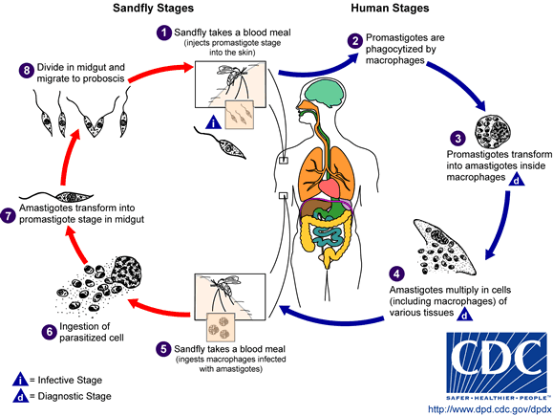
The life cycle of Leishmania

Slide 6
The life cycle of Leishmania

Slide 7
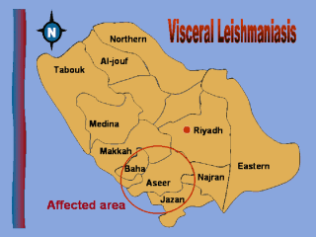
Visceral Leishmaniasis

Slide 8
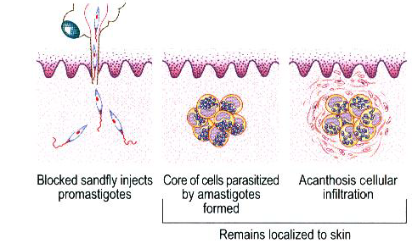
Pathogenesis of Visceral Leishmaniasis
1-Leishmanioma:
Small papule --- Nodule (rarely Ulcerate) ----- Amastigote within skin macrophages.
N.B: - Effective cellular immune response controls dissemination of infection.
Malnutrition & Immunosuppression --- contribute in disease development.
V.L. is an immunosuppressive disease.
Children & young Adults are more susceptible to the infection.
Immunocompromized develop highly fatal severely progressive disease.

Slide 9
Pathogenesis of Visceral Leishmaniasis
2- Incubation period: several months to years, now it can be few days
3- Infection spread from primary skin lesion haematogenously to organs R.E.S. (BONE MARROW – LYMPHOID TISSUE – SPLEEN – LIVER – G.I.T …etc.
4-Amastigote multiply intracellularly granulomatous reaction Hyperplasia & Hypertrophy of affected organ.
Progressive disease may lead to the followings:
1-Bone marrow suppression PANCYTOPENIA ( Anemia – Leucopenia /Neutropenia “tendency to bacterial infection” – Thrombocytopenia “bleeding tendency”).
2- Massive Splemomegaly early destruction & short life
span of R.B.Cs Anemia.

Slide 10
Pathogenesis of Visceral Leishmaniasis
Progressive disease may lead to the followings:
3- Secondary bacterial infection ( due to Neutropenia / compromised immunity / malnutrition) Otitis media – Pneumonia - Septicemia
4- Liver affection reversed A/G ratio Hypoalbuminaemia Oedema.
5- Immune complexes mild glomerulonephritis (deposition of C.I.C. in glomerular capillaries) Nephrotic syndrome may lead to death.

Slide 11
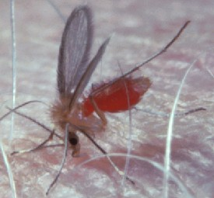
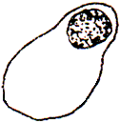
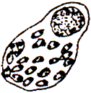
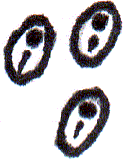
Pathogenesis of Visceral Leishmaniasis
Leishmanioma is rarely seen at the site of bite
Via blood stream to
Taken by
Promastigotes
Amastigotes
Reticulo-endothelial cells present in human viscera
Liver:
hepatomegaly
RBCs
Spleen:
splenomegaly
marrow
WBCs
Lymph nodes:
enlarged
Bone marrow:
Anaemia,
leukopenia,
thrombocytopenia
Platelets
Reversal of albumin / globulin ratio
Intestinal mucosa:
diarrhoea & dysentery

Slide 12
Clinical picture of Visceral Leishmaniasis
Asymptomatic “ most common”
Symptomatic infections may lead to the following:
1- Leishmanioma (Primary skin lesion).
2- Fever: irregular – prolonged – intermittent (2-3 peaks daily).
dromedary fever
3- Splenomegaly: progressively enlarged /soft / tender
4- Hepatomegaly: progressively enlarged /soft / tender
5- Lymphadenopathy.
6- Jaundice.
7- Skin is darkly Pigmented at face , hands & feets
8- Diarrhea or Dysentery.
9- Weight loss.

Slide 13
Clinical Picture of Visceral Leishmaniasis
1- Fever: intermittent with double daily rise.
Also called Dum-dum fever
(Dum-dum is a town in Calcutta in India)
2- hepatosplenomegaly
NWVL hepatosplenomegaly
OWVL hepatosplenomegaly

Slide 14
Clinical Picture of Visceral Leishmaniasis
3- Skin changes
Disturbance of pigmentation occurs
Dark pigmentation or depigmentation (butterfly pigmentation)
(also called Kala azar كلمة باللغة الهندية means black fever)
4- Post kala azar dermal leishmanoid (PKDL)
Skin nodules.
Persistent allergic reaction to parasite antigens
Seen in two conditions
1- Spontaneous arrest of the disease
2- Incomplete antimony treatment
5- Weight loss, emaciation, death from inter-current infection (cancrum oris, pulmonary, gastrointestinal infections).
Leishmania causes suppression of cell-mediated immunity

Slide 15
Post KALA-AZAR Dermal Leishmaniasis
(P.K.D.L)
* About 15-20% of V.L. patients develop P.K.D.L in 1-5 years post infection
* Skin lesion develops after apparent cure or shortly after or during treatment
Lesions appear as follows:
(A)- Multiple depigmented macules /papules/nodules.
(B)- Common in face resemble “Lepromatous leprosy” –
Limbs – upper trunk.
(C)- Chronic persistent lesion rarely ulcerate.

Slide 16
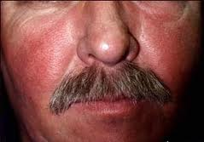
Skin changes in visceral leishmaniasis
Butterfly pigmentation
Post Kala-Azar dermal leishmanoid
Usually occur in patients from the old world
Depigmented areas

Slide 17
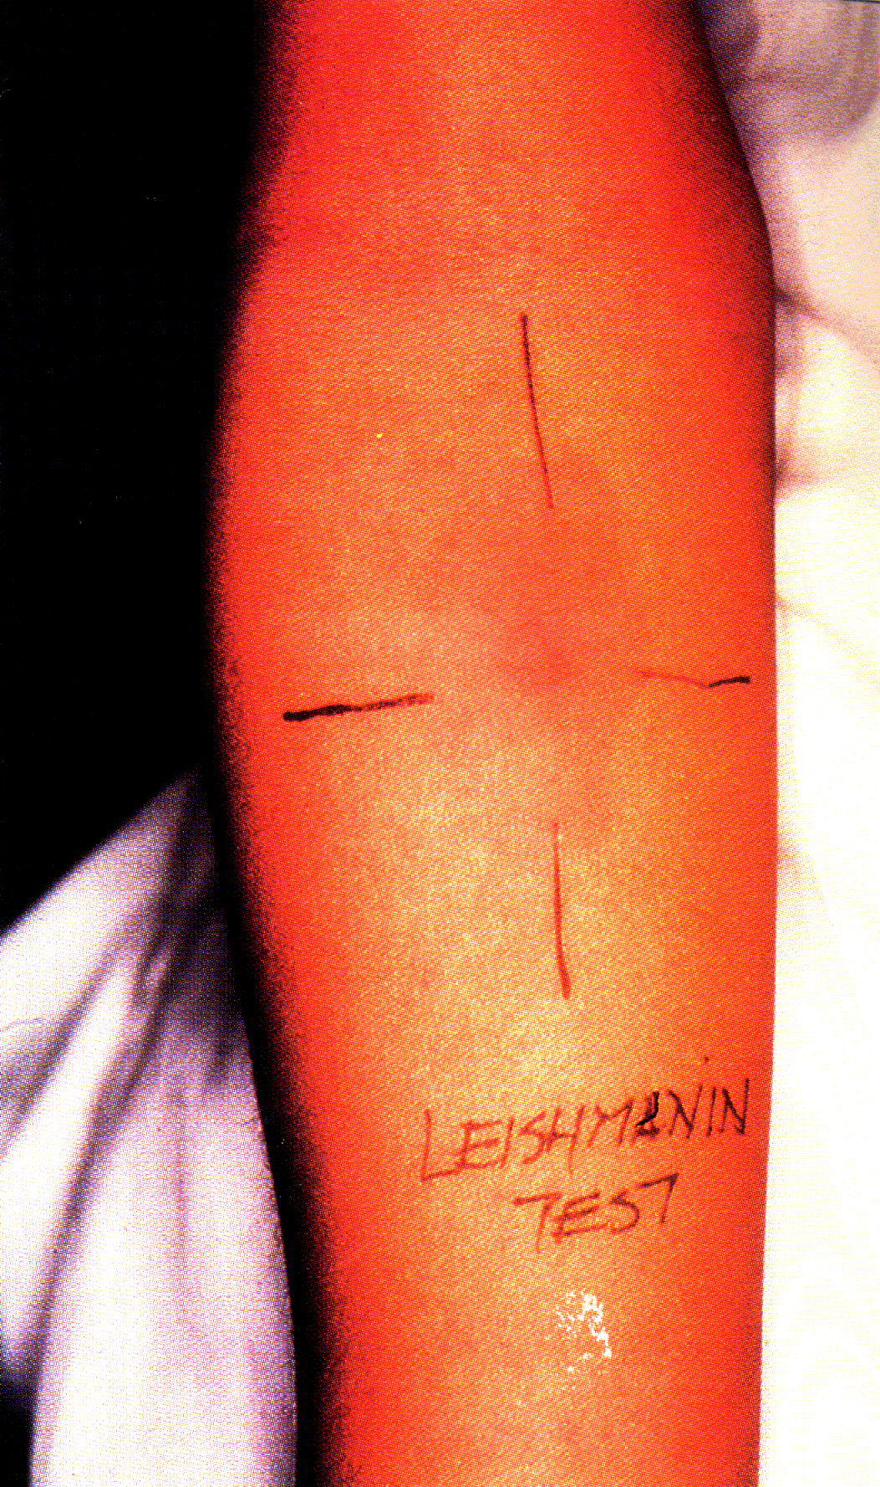
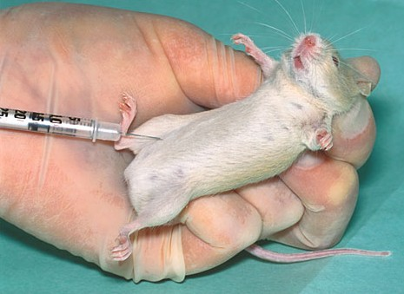
Diagnosis of
C. Leishmaniasis
V. Leishmaniasis
Clinically:
Amastigotes
Clinically:
Necrotic tissue
Ulcer with sharp cut indurated margin
Fever, hepatosplenomegaly
Microscopy:
Microscopy:
To detect amastigotes at the edge of the ulcer by aspiration or biopsy
To detect amastigotes in blood, liver, spleen, lymph node, bone marrow
Culture:
Culture:
To detect promastigotes
To detect promastigotes
Animal inoculation
Montenegro test
Montenegro test
˃ 95%
+ve after successful treatment
Serological tests
Serological tests

Slide 18
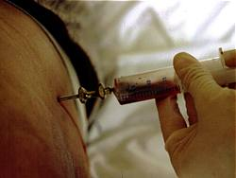
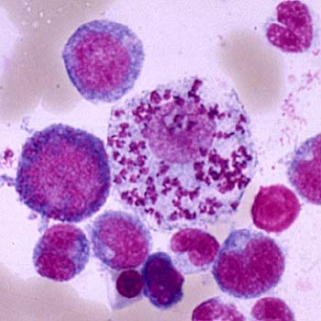
Aspiration and biopsy from Bone marrow
Bone marrow Amastigote
Bone marrow aspiration
Supportive Laboratory Findings:
1- Reversal A/G ratio. 2- Hypergammaglobinaemia.
3- Anemia. 4- Neutropenia.
5- Thrombocytopenia.

Slide 19
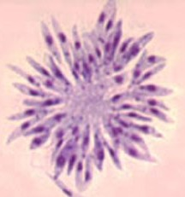
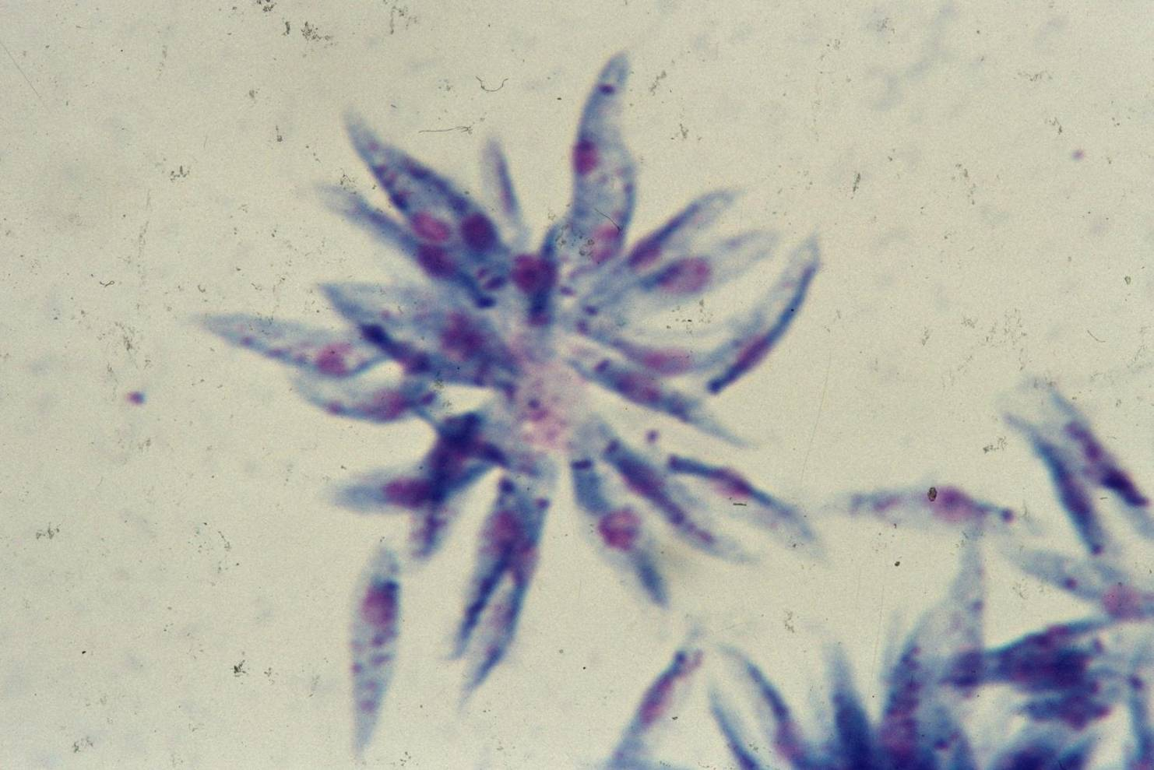
Diagnosis (cont.)
Promastigotes in rosettes in a culture of an orient sore on N.N.N. medium (Giemsa stain).
Montenegro “Leishmanin” Test:
1-Detects Delayed type Hypersensitivity.
2- -ve during acute stage of V.L.
3- +ve after cure.
4- Negative for D.C.L. (suppressed immunity).
5- In Endemic areas, high % of population are positive.

Slide 20
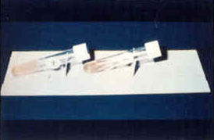
Diagnosis (cont.)
Immunological Diagnosis:
Specific serologic tests: Direct Agglutination Test (DAT), ELISA, IFAT
Non specific detection of hypergammaglobulinaemia by formaldehyde (formol-gel) test or by electrophoresis.

Slide 21
Buffy Coat Method
A technique used for collection of parasite from blood sample
Plasma
WBCs, platelets, parasite
Buffy coat
RBCs
Centrifuge
Patient’s blood

Slide 22
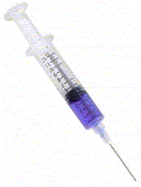
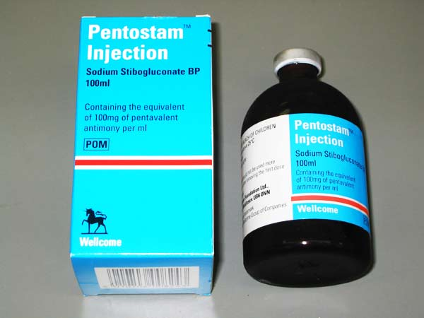
Treatment
Cutaneous leishmaniasis
Visceral leishmaniasis
Antimony sodium gluconate (Pentostam)
Given intramuscularly
Treatment of ulcer
Surgical excision
Curettage
Physical
Heat, freezing
2% chlopromazine & clortrimazole
Chemical
I.D. injection of interferon gamma around the lesion to promote healing of the ulcer

Slide 23
Control of Leishmaniasis
Treatment of Patients
Protection: by using
Wire screens, repellents & mosquito nets
Control of sandfly vector
Vaccination in endemic areas gives long lasting immunity

